Slide 1
Problem solving with possible outcomes
Probability: possible outcomes

Slide 2
How our teaching resources are designed for the classroom

Slide 3
I can choose an appropriate diagram to display the outcomes for different events.

Slide 4
Likelihood describes the chance that a particular event occurs.
An outcome table is a table that shows all the possible outcomes.
Each branch of an outcome tree shows a possible outcome from an event or from a stage of a trial. The full outcome tree shows all possible outcomes.
Venn diagrams are a representation used to model statistical/probability questions. Commonly circles are used to represent events.

Slide 5

Problem solving with possible outcomes
Outcome tables and likelihood
Outcomes and unequal likelihood

Slide 6
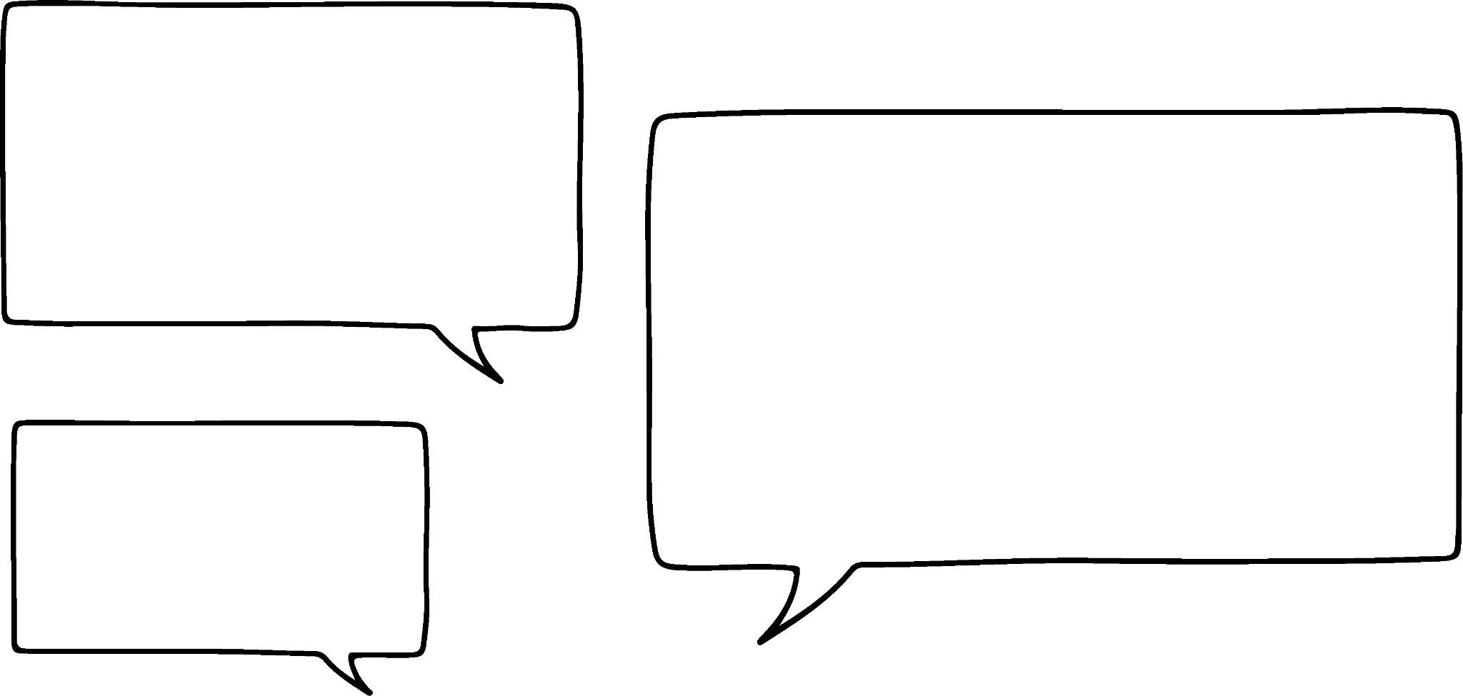

Outcome tables and likelihood
 | A | B | C
A | AA | BA | CA
B | AB | BB | CB
C | AC | BC | CC
If I were to spin spinner 1 twice, I could display the outcomes in this table.
A
B
C
spinner 1
Sofia

Slide 7
Outcome tables and likelihood
 | A | B | C
A | AA | BA | CA
B | AB | BB | CB
C | AC | BC | CC
But if I were to spin spinner 2 twice, would the outcome table also look like this…
A
B
C
or this?
spinner 1
 | A | A | A | B | C | C
A | AA | AA | AA | BA | CA | CA
A | AA | AA | AA | BA | CA | CA
A | AA | AA | AA | BA | CA | CA
B | AB | AB | AB | BB | CB | CB
C | AC | AC | AC | BC | CC | CC
C | AC | AC | AC | BC | CC | CC
Sofia
 | A | B | C
A | AA | BA | CA
B | AB | BB | CB
C | AC | BC | CC
C
A
A
B
C
A
spinner 2

Slide 8

Outcome tables and likelihood
 | A | B | C
A | AA | BA | CA
B | AB | BB | CB
C | AC | BC | CC
 | A | A | A | B | C | C
A | AA | AA | AA | BA | CA | CA
A | AA | AA | AA | BA | CA | CA
A | AA | AA | AA | BA | CA | CA
B | AB | AB | AB | BB | CB | CB
C | AC | AC | AC | BC | CC | CC
C | AC | AC | AC | BC | CC | CC
This table is helpful for showing the number of unique outcomes efficiently.
If order matters, then there are 9 unique outcomes.
This table is helpful for showing which outcome is most likely to occur.
I think both are correct.
They just have different uses.
But if order doesn’t matter (e.g. AC is the same as CA), then there are 6 unique outcomes.
If order matters, then AA is the most likely outcome (9 outcomes).
If order doesn’t matter, then AC is the most likely outcome (12 outcomes).
Jun

Slide 9



Outcome tables and likelihood
table 1
table 2
 | 1 | 0
H | 1H | 0H
T | 1T | 0T
 | 1 | 1 | 1 | 1 | 0 | 0
H | 1H | 1H | 1H | 1H | 0H | 0H
T | 1T | 1T | 1T | 1T | 0T | 0T
0
1
1
1
Which of these statements are correct for table 2?
0
1
a
It efficiently shows there are four unique outcomes.
spinner
b
It shows the likelihood of the different outcomes.
c
It is the quicker table to construct.
coin
{heads, tails}
d
The two most common outcomes are equally likely.

Slide 10
Outcome tables and likelihood
table 1
table 2
 | 1 | 0
H | 1H | 0H
T | 1T | 0T
 | 1 | 1 | 1 | 1 | 0 | 0
H | 1H | 1H | 1H | 1H | 0H | 0H
T | 1T | 1T | 1T | 1T | 0T | 0T
0
1
1
1
These two statements are correct for table 1.
0
1
a
It efficiently shows there are four unique outcomes.
spinner
c
It is the quicker table to construct.
coin
{heads, tails}

Slide 11
Outcome tables and likelihood
Jun plays a game.
He will spin both spinners once each, and multiply the outcomes of each spinner.
If the outcome is a prime number, Jun wins a prize.
If the outcome isn’t a prime number, he wins nothing.
2
3
5
Jun
spinner 1
2
6
6
6
6
6
spinner 2

Slide 12
Outcome tables and likelihood
table 1
Jun wants to construct a table to see whether it is possible for him to win the game.
× | 2 | 3 | 5
2 | 4 | 6 | 10
6 | 12 | 18 | 30
Which of these tables is most appropriate for the purpose of Jun’s trial.
Select the correct justification for your choice.
table 2
table 1
1
table 2
2
× | 2 | 3 | 5
2 | 4 | 6 | 10
6 | 12 | 18 | 30
6 | 12 | 18 | 30
6 | 12 | 18 | 30
6 | 12 | 18 | 30
6 | 12 | 18 | 30
a
This table shows how likely Jun is to win.
b
This table efficiently shows all unique outcomes.

Slide 13
Outcome tables and likelihood
table 1
× | 2 | 3 | 5
2 | 4 | 6 | 10
6 | 12 | 18 | 30
Jun wants to see whether it is possible to win.
He does not care how likely it is that he wins.
Table 1 shows all the unique outcomes, and none of them are prime numbers.
Therefore, it is not possible for Jun to win.
There was no need to list all the individual outcomes in table 2.
table 2
× | 2 | 3 | 5
2 | 4 | 6 | 10
6 | 12 | 18 | 30
6 | 12 | 18 | 30
6 | 12 | 18 | 30
6 | 12 | 18 | 30
6 | 12 | 18 | 30

Slide 14
Outcome tables and likelihood
1) Alex will spin this spinner twice.
a) Complete this outcome table to list all unique outcomes.
2) Aisha will spin spinner 2 and spinner 3 once each, and find the product of the numbers the spinners land on.
A
B
4
1
A
A
4
4
spinner 1
spinner 2
a) Complete this outcome table to list all unique outcomes.
 | A | B
A
B
× | 1
2
3
2
spinner 3
b) Construct your own outcome table which shows the most likely outcome.
b) Construct a second outcome table. Starting with the least likely outcome, rank the outcomes in order of likelihood.

Slide 15
Outcome tables and likelihood
3) Sam and Lucas play a game.
Sam will spin spinner 4 twice and find the sum of the numbers the spinner lands on.
If the score is a double-digit number, Sam wins, if the score is either 8 or 9, it’s a draw, and if the score is 7 or less, Lucas wins.
a) Construct the most efficient outcome table to show it is impossible for Sam and Lucas to draw.
b) Construct the most efficient outcome table to find whether Sam or Lucas is more likely to win. Explain how you know.
5
2
5
5
spinner 4

Slide 16
Outcome tables and likelihood
1) Alex will spin this spinner twice.
a) Complete this outcome table to list all unique outcomes.
A
B
A
A
 | A | A | A | B
A | AA | AA | AA | BA
A | AA | AA | AA | BA
A | AA | AA | AA | BA
B | AB | AB | AB | BB
spinner 1
 | A | B
A | AA | BA
B | AB | BB
b) Construct your own outcome table which shows the most likely outcome.
The outcome AA is the most likely, appearing 9 times.
Even if order didn’t matter, AB only appears 6 times.

Slide 17
Outcome tables and likelihood
2) Aisha will spin spinner 2 and spinner 3 twice, and find the product of the numbers the spinners land on.
4
1
4
4
spinner 2
 | 1 | 4 | 4 | 4
2 | 2 | 8 | 8 | 8
2 | 2 | 8 | 8 | 8
3 | 3 | 12 | 12 | 12
a) Complete this outcome table to list all unique outcomes.
× | 1 | 4
2 | 2 | 8
3 | 3 | 12
2
3
2
spinner 3
b) Construct a second outcome table. Starting with the least likely outcome, rank the outcomes in order of likelihood.
Order of likelihood:
3 → 2 → 12 → 8

Slide 18
Outcome tables and likelihood
3) Sam and Lucas play a game.
Sam will spin spinner 4 twice and find the sum of the numbers the spinner lands on.
If the score is a double-digit number, Sam wins, if the score is either 8 or 9, it’s a draw, and if the score is 7 or less, Lucas wins.
a) Construct the most efficient outcome table to show it is impossible for Sam and Lucas to draw.
5
2
5
5
spinner 4
 | 2 | 5
2 | 4 | 7
5 | 7 | 10
There are no outcomes that are either 8 or 9.

Slide 19
Outcome tables and likelihood
3) Sam and Lucas play a game.
Sam will spin spinner 4 twice and find the sum of the numbers the spinner lands on.
If the score is a double-digit number, Sam wins, if the score is either 8 or 9, it’s a draw, and if the score is 7 or less, Lucas wins.
b) Construct the most efficient outcome table to find whether Sam or Lucas are more likely to win. Explain how you know.
5
2
5
5
spinner 4
 | 2 | 5 | 5 | 5
2 | 4 | 7 | 7 | 7
5 | 7 | 10 | 10 | 10
5 | 7 | 10 | 10 | 10
5 | 7 | 10 | 10 | 10
Sam is more likely to win, as there are 9 double-digit outcomes, but only 7 outcomes that are 7 or less.

Slide 20
Problem solving with possible outcomes
Outcome tables and likelihood
Outcomes and unequal likelihood

Slide 21
Outcomes and unequal likelihood
Sofia will spin spinners 1 and 2 once each.
So, if I can use an outcome table to see which outcomes are more likely, then…
B
B
B
A
B
 | A | B | B | B | B
C | AC | BC | BC | BC | BC
C | AC | BC | BC | BC | BC
D | AD | BD | BD | BD | BD
spinner 1
Sofia
C
The outcome BC is obviously the most likely one to happen.
By looking at spinner 1 and spinner 2…
Why is Sofia’s statement incorrect?
C
D
spinner 2

Slide 22
Outcomes and unequal likelihood
Sofia will spin spinners 1 and 2 once each.
You can’t say that for certain.
I don’t think all the outcomes on these spinners are equally likely, since some sectors are different in size.
A
B
A
B
A
B
A
A
B
A
A
A
A
spinner 1
I think each spinner now only has outcomes that are equally likely.
This means each outcome of a outcome table we make is equally likely to happen.
Jun
D
C
D
C
D
D
D
spinner 2

Slide 23
Outcomes and unequal likelihood
Sofia will spin spinners 1 and 2 once each.
 | C | C | D | D | D | D
A | AC | AC | AD | AD | AD | AD
A | AC | AC | AD | AD | AD | AD
A | AC | AC | AD | AD | AD | AD
A | AC | AC | AD | AD | AD | AD
A | AC | AC | AD | AD | AD | AD
A | AC | AC | AD | AD | AD | AD
A | AC | AC | AD | AD | AD | AD
A | AC | AC | AD | AD | AD | AD
B | BC | BC | BD | BD | BD | BD
B | BC | BC | BD | BD | BD | BD
B | BC | BC | BD | BD | BD | BD
B | BC | BC | BD | BD | BD | BD
A
B
AD is the most likely outcome, not BC.
A
B
A
B
A
B
A
A
A
A
spinner 1
D
C
D
C
D
D
spinner 2

Slide 24

Outcomes and unequal likelihood
Laura will spin this spinner twice, and find the sum of the numbers the spinner lands on.
It’s pretty obvious that 8 is the most likely outcome, as there are more 4s than any other number on the spinner.
-3
4
-3
4
-4
-3
4
spinner
Laura
Which of these statements explain why Laura is incorrect?
+ | 4 | 4 | 4 | -4
4 | 8 | 8 | 8 | 0
4 | 8 | 8 | 8 | 0
4 | 8 | 8 | 8 | 0
-4 | 0 | 0 | 0 | -8
The outcomes of the spinner aren’t all equally likely.
a
b
There are more 4s than -4s.
c
The -4 sector has the same area as the total area of the 4 sectors.
d
The spinner has too many sectors.

Slide 25
Outcomes and unequal likelihood
Laura will spin this spinner twice, and find the sum of the numbers the spinner lands on.
+ | 4 | 4 | 4 | -4 | -4 | -4
4 | 8 | 8 | 8 | 0 | 0 | 0
4 | 8 | 8 | 8 | 0 | 0 | 0
4 | 8 | 8 | 8 | 0 | 0 | 0
-4 | 0 | 0 | 0 | -8 | -8 | -8
-4 | 0 | 0 | 0 | -8 | -8 | -8
-4 | 0 | 0 | 0 | -8 | -8 | -8
-4
4
-4
4
-4
4
spinner
Each sector of the spinner represents an equally likely outcome.
Which of these statements is correct.
a
There are four equally likely outcomes.
b
There are four unique outcomes.
c
The outcomes of 8 and -8 are equally likely.
d
0 is the most likely outcome.

Slide 26
Outcomes and unequal likelihood
So, it is important to make sure the area of each sector is equal in size before you can look at likelihood…
A
B
A
A
A
A
spinner 1
Sofia
… But, how do you make sure the spinner is equally likely to land on each sector?

Slide 27
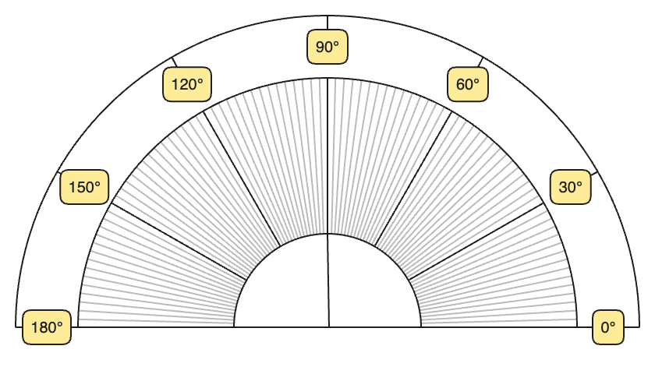
Outcomes and unequal likelihood
I think you can use a protractor to measure the angle of the smallest sector…
A
B
72°
72°
A
A
A
A
Jun
spinner 1
And split up any larger sector into multiple smaller sectors.

Slide 28
Outcomes and unequal likelihood
I wonder if it’s possible to draw an outcome tree to show which outcome is most likely?
A
B
72°
72°
A
A
A
It’s definitely possible, but won’t it have lots of branches because there are so many sectors?
I think outcome trees are a lot better for showing unique outcomes only… That means a lot fewer branches!
Jun
spinner 1
Jun will spin spinner 1 twice.
Sofia

Slide 29
Outcomes and unequal likelihood
A
A A
Outcome tree showing each unique outcome.
A
B
A B
A
B A
B
A
B
B
B B
72°
72°
A | A
A | A
A | A
A | A
A | B
A | A
A | A
A | A
A | A
A | B
A | A
A | A
A | A
A | A
A | B
A | A
A | A
A | A
A | A
A | B
B | A
B | A
B | A
B | A
B | B
A
A
A
A
A
A
Outcome tree showing the likelihood of each outcome.
A
A
B
A
A
A
spinner 1
A
A
B
Jun will spin spinner 1 twice.
A
A
A
A
A
B
A
A
A
A
A
B
A
B
A
A
A
B

Slide 30
Outcomes and unequal likelihood
When showing likelihood, I’m going to stick to outcome tables.
Outcome tree showing each unique outcome.
But they get really messy when looking at likelihood because there are so many branches!
You’re right!
Outcome trees are so useful for listing unique outcomes.
A
A A
A
B
A B
A
B A
B
B
B B
A
A | A
A | A
A | A
A | A
A | B
A | A
A | A
A | A
A | A
A | B
A | A
A | A
A | A
A | A
A | B
A | A
A | A
A | A
A | A
A | B
B | A
B | A
B | A
B | A
B | B
A
A
A
Outcome tree showing the likelihood of each outcome.
Jun
A
B
 | A | A | A | A | B
A | AA | AA | AA | AA | AB
A | AA | AA | AA | AA | AB
A | AA | AA | AA | AA | AB
A | AA | AA | AA | AA | AB
B | BA | BA | BA | BA | BB
A
A
A
A
A
B
A
A
A
A
A
B
A
A
A
A
A
B
Outcome table showing the likelihood of each outcome.
A
B
A
A
A
B

Slide 31
Outcomes and unequal likelihood
The three sectors whose outcomes are B and C are all equally likely.
How many smaller sectors should the sector with outcome A be split up into so that all outcomes on the spinner are equally likely?
B
B
45°
225°
A
C
spinner
225° ÷ 45° = 5
The sector with outcome A should be split into 5 smaller sectors.

Slide 32
Outcomes and unequal likelihood
1
1
4
6
2
7
1
4
6
3
6
5
4
4
6
4
4
spinner A
spinner B
spinner C
1) Jacob will spin spinners A and B once each, with the number each spinner lands on multiplied together. Construct an outcome table which lists each unique outcome to this trial.
2) Split sectors on spinners A, B, C so that all outcomes on a spinner are equally likely.

Slide 33
Outcomes and unequal likelihood
1
1
4
6
2
7
1
4
6
3
6
5
4
4
6
4
4
spinner A
spinner B
spinner C
3) Jacob will spin spinners B and C once each, with the number each spinner lands on multiplied together. Construct an outcome table which shows how likely each outcome is to occur.
4) Jacob will spin spinners A and B once each, then spinners B and C once each, then spinners A and C once each. After each trial, the number each spinner lands on are multiplied together.
Which outcome is most likely to occur across all experiments?

Slide 34
Outcomes and unequal likelihood
1
4
6
2
5
7
1
4
6
3
4
4
6
5
spinner A
spinner B
spinner C
1) Jacob will spin spinners A and B once each, with the number each spinner lands on multiplied together. Construct an outcome table which lists each unique outcome to this trial.
2) Split sectors on spinners A, B, C so that all outcomes on a spinner are equally likely.
 | 1 | 4
2 | 2 | 8
3 | 3 | 12
6 | 6 | 24

Slide 35
Outcomes and unequal likelihood
1
4
6
2
5
7
1
4
6
3
4
4
6
5
spinner A
spinner B
spinner C
3) Jacob will spin spinners B and C once each, with the number each spinner lands on multiplied together. Construct an outcome table which shows how likely each outcome is to occur.
(BC) | 2 | 3 | 6 | 6 | 6
7 | 14 | 21 | 42 | 42 | 42
5 | 10 | 15 | 30 | 30 | 30
5 | 10 | 15 | 30 | 30 | 30
The outcome 30 appears 6 times out of 15 total outcomes.

Slide 36
Outcomes and unequal likelihood
4) Jacob will spin spinners A and B once each, then spinners B and C once each, then spinners A and C once each. After each trial, the number each spinner lands on are multiplied together.
Which outcome is most likely to occur across all experiments?
(AB) | 2 | 3 | 6 | 6 | 6
1 | 2 | 3 | 6 | 6 | 6
1 | 2 | 3 | 6 | 6 | 6
4 | 8 | 12 | 24 | 24 | 24
4 | 8 | 12 | 24 | 24 | 24
4 | 8 | 12 | 24 | 24 | 24
4 | 8 | 12 | 24 | 24 | 24
(AC) | 7 | 5 | 5
1 | 7 | 5 | 5
1 | 7 | 5 | 5
4 | 28 | 20 | 20
4 | 28 | 20 | 20
4 | 28 | 20 | 20
4 | 28 | 20 | 20
20 is the most likely outcome to occur.
The outcome 24 appears 12 times out of 30 total outcomes.
The outcome 20 appears 8 times out of 18 total outcomes.

Slide 37
Outcomes and unequal likelihood
4) Jacob will spin spinners A and B once each, then spinners B and C once each, then spinners A and C once each. After each trial, the number each spinner lands on are multiplied together.
Which outcome is most likely to occur across all experiments?
AC The outcome 20 appears 8 times out of 18 total outcomes.
AB The outcome 24 appears 12 times out of 30 total outcomes.
BC The outcome 30 appears 6 times out of 15 total outcomes.
20 is the most likely outcome to occur.
BC
AB
AC
unlikely
likely
impossible
even chance
certain

Slide 38
Problem solving with possible outcomes
An outcome table can show the number of unique outcomes of a two-stage trial.
An outcome table can also show the number of individual outcomes of a two-stage trial, where some outcomes of at least one stage are repeated.

Slide 39

© Oak National Academy 2024.
Produced in partnership with Mathematics in Education and Industry.
Licensed on the Open Government Licence v3.0, except where otherwise stated. See Oak terms and conditions.

